Slide 1
Sentiment Analysis
Team Hawk solo

Slide 2


The team – Solo hawk
Working as a Proposal Coordinator on a global scale. Time constraints since working on global tenders.
Work from home
Currently, our company is working on formulating on a survey questionnaire, wants to assist in the developing
Graduated with an Associate Degree in Computer Science and Bachelors of Science in Business Administration.

Slide 3

The problem
We would like to have in our CRM portal to have a moving statistics for survey responses.
Intends to use open ended questionnaires as well as Likert Scale
Likert Scale is quantifiable and can be statistically studied, while open ended questions scaling is challenging.
As such, such sentiment response outside the Likert Scale when scored, helps the sale team a lot to determine if it a positive or a negative comment

Slide 4
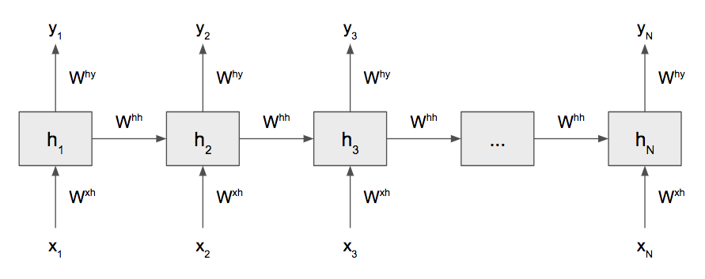
solution
I would like to find a way using ML to predict a score on clients comments, thus providing the end user an idea if the client is happy or not
I would gather sample sentiment data from Amazon to model positive and negative sentiment.
I shall use Recurrent neural networks (RNN) the state of the art algorithm for sequential data and are used by Apple's Siri and Google's voice search. It is the first algorithm that remembers its input, due to an internal memory, which makes it perfectly suited for machine learning problems that involve sequential data.

Slide 5
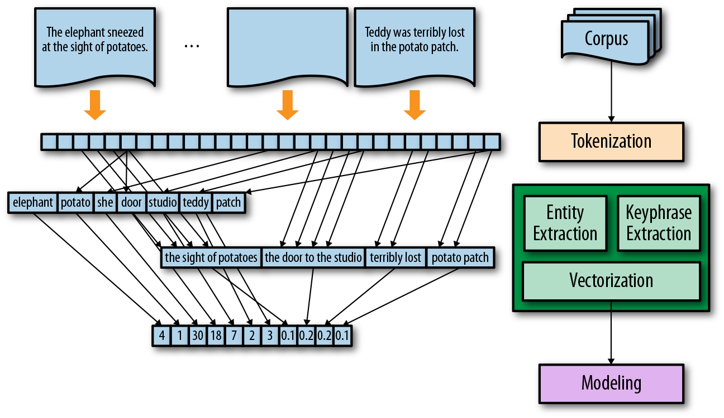
The Tokenization and Sequence Encoding

Slide 6
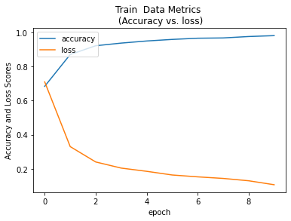
RNN Model Training Data Metrics

Slide 7
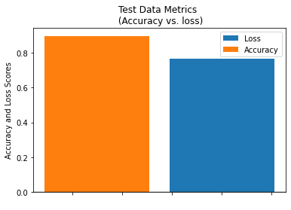
RNN Model test Data Metrics

Slide 8
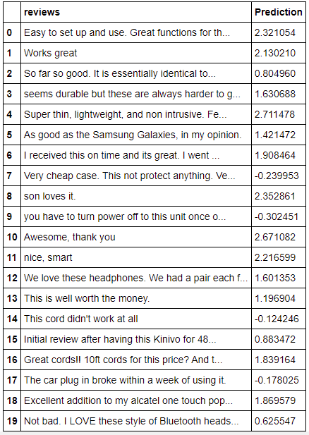
Remark sampling

Slide 9

Thank you.

